Slide 1
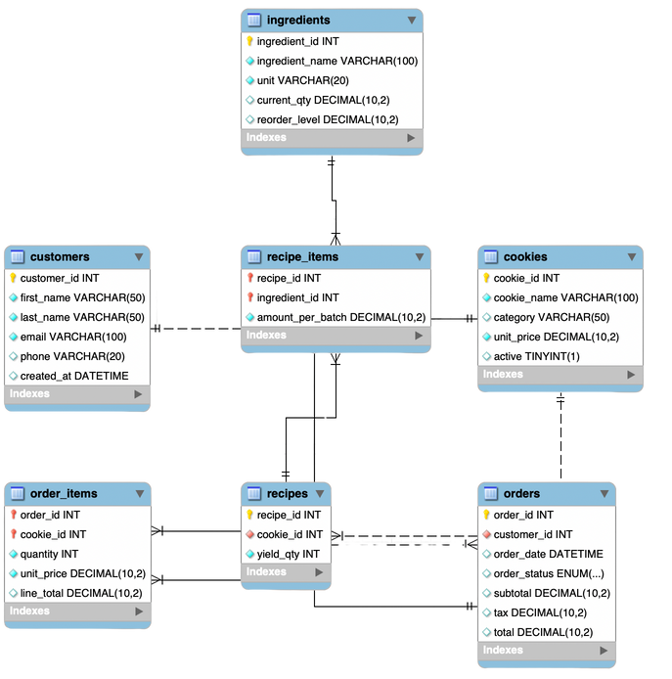




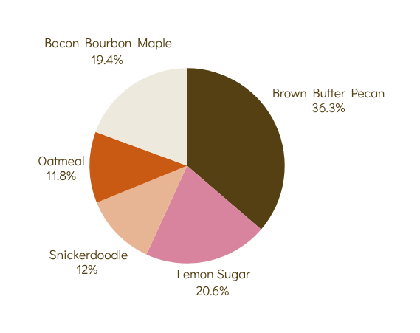


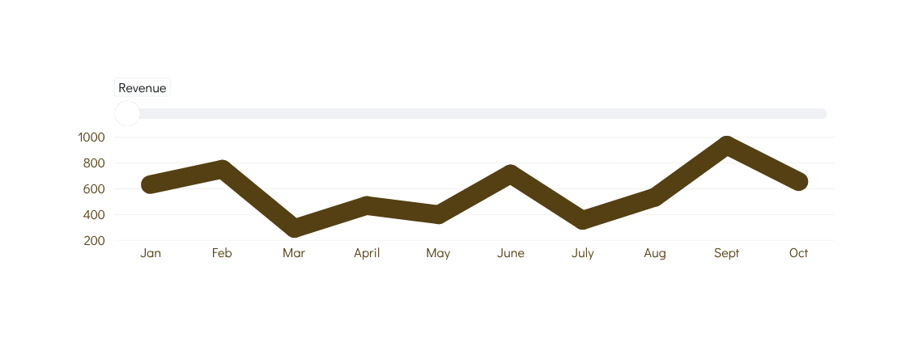
From Dough to Data
Building the Butter & Salt Cookie Database
Breanna Jordan- Spring 2025
APCV 498 Senior Capstone
Business Insight
Database Schema
Overview of the Project
  Which cookies consistently lead in sales, according to the database?
  How can we boost revenue during our slow months?
  What business insights become possible because of the way this schema is designed?”
This project designed a MySQL relational database for Butter & Salt, a small-batch cookie business. The goal was to streamline customer orders, track ingredients, manage recipes, and generate business insights efficiently.
Conclusions
The database built for Butter & Salt provides the clarity needed to understand customer trends, top-selling items, and seasonal patterns. By turning raw orders into actionable insights, the system supports smarter planning and more efficient operations as the bakery grows.
Data Snapshot
Technologies
Validated with 400+ orders, 200 customers, and 20 ingredients, the database simulates real small bakery data.
Future Work
Top 5 Cookies
  Add a web-based order form
  Create a dashboard for analytics
  Integrate real-time sales data
References
Objectives
  Normalize data to 3NF
  Improve order and inventory tracking
  Generate business insights
  Ensure calability for future growth
Revenue

